Slide 1
Interactive Visual Data Analysis
06 – Visualization of temporal data

Slide 2
Objectives
How to deal with time: Learn about data with temporal dependencies
How to visualize data with temporal dependencies: Learn visualization techniques for time-oriented data

Slide 3
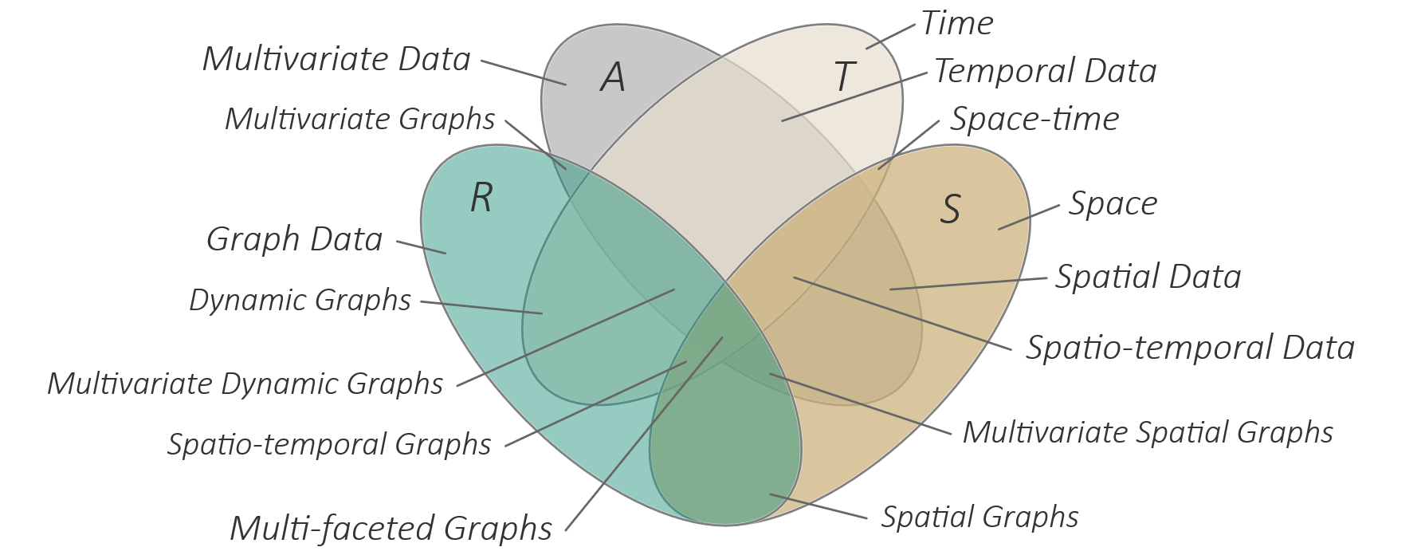
Overview
Visualization of temporal data
Time and temporal data
Fundamental visualization strategies
Concrete visualization techniques
The TimeViz Browser

Slide 4
Motivation
So far, we considered the visualization of multivariate data attributes A without explicitly being concerned with the data’s frame of reference
However, many real-world data analysis problems are related to time T and space S
To arrive at expressive, effective, and efficient solutions, we need to take into account the specifics of time T and space S
Today: Time T
Next lecture: Space S

Slide 5
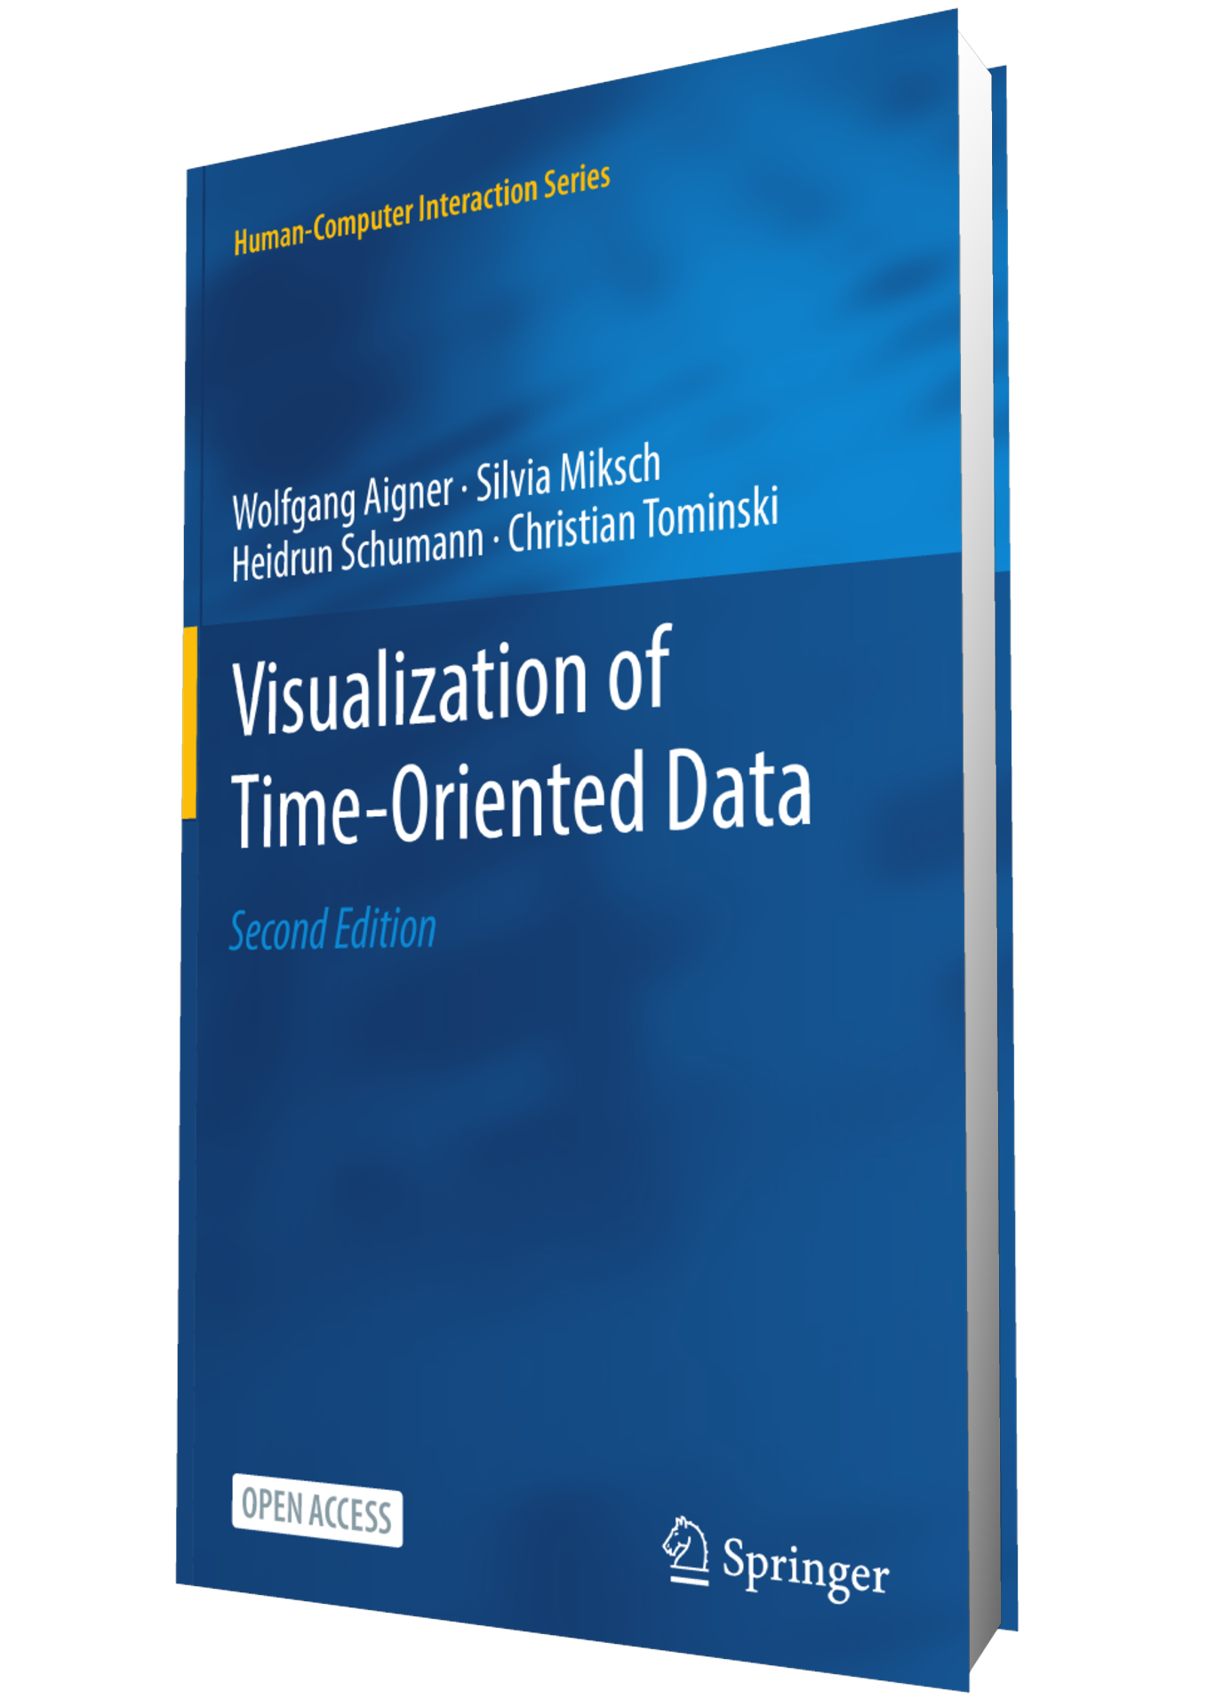
Visualization of temporal data
Time is an exceptional dimension
Virtually everything around us is related to time
Many data analyses seek to understand data in relation to time: “How do data attributes behave wrt. time: T → A ?”
For appropriate visualization, we need to know
Characteristics of time and temporal data
Analytical questions being asked for temporal data
Visualization techniques taking specifics of time into account
Note: We can fill a whole book with this topic
https://timeviz.net

Slide 6
Characterization of time and temporal data
Dimension of time
Scale
Primitives
Arrangement
Granularity
Structure
Connection of time and data
Non-temporal vs. temporal data
Static vs. dynamic data

Slide 7
Characterization of time
Temporal scale
As for regular data: ordinal (“before”), discrete (“2022-03-24”), and continuous (“1.5878 ms”) time
Temporal primitives
Instants
Singular point in time
No temporal extent
Intervals
Have an extent
Defined by two time instants or by one instant plus duration

Slide 8
Characterization of time
Temporal arrangement
Describes how temporal primitives are aligned in time
Linear: Linearly arranged time primitives (e.g., dates)
Cyclic: Cyclically arranged time primitives (e.g., seasons, hours of the day)
Temporal granularity
Single granularity
Data available only at one scale, typical for continuous (measured) time
Multiple granularities
Time organized hierarchically into different levels of detail
Examples: Days, months, years, decades, centuries vs. days, weeks, years
Beware of inconsistencies, for instance, leap years or overlapping week and months.

Slide 9
Characterization of time
Structure of time
Ordered time
Time progresses along a single axis
Example: Stock market data
Branching time
Different alternative paths of time exist of which only one will eventually be taken
Example: Planning scenarios
Time with multiple perspectives
Several alternative timelines exists simultaneously
Example: Eye witness reports

Slide 10
Characterization of time
Don’t forget about the time scale, which can be ordinal, discrete, or continuous.
Summary

Slide 11
Characterization of temporal data
We now know about the characteristics of time
Next: How can data attributes A be related to time T?
Notes:
Static, non-temporal data: player statistics in sports data
Dynamic, non-temporal data: live sensor data
Static, temporal data: financial data, health data
Dynamic, temporal data: streaming data, news, tweets, sensor data with history

Slide 12
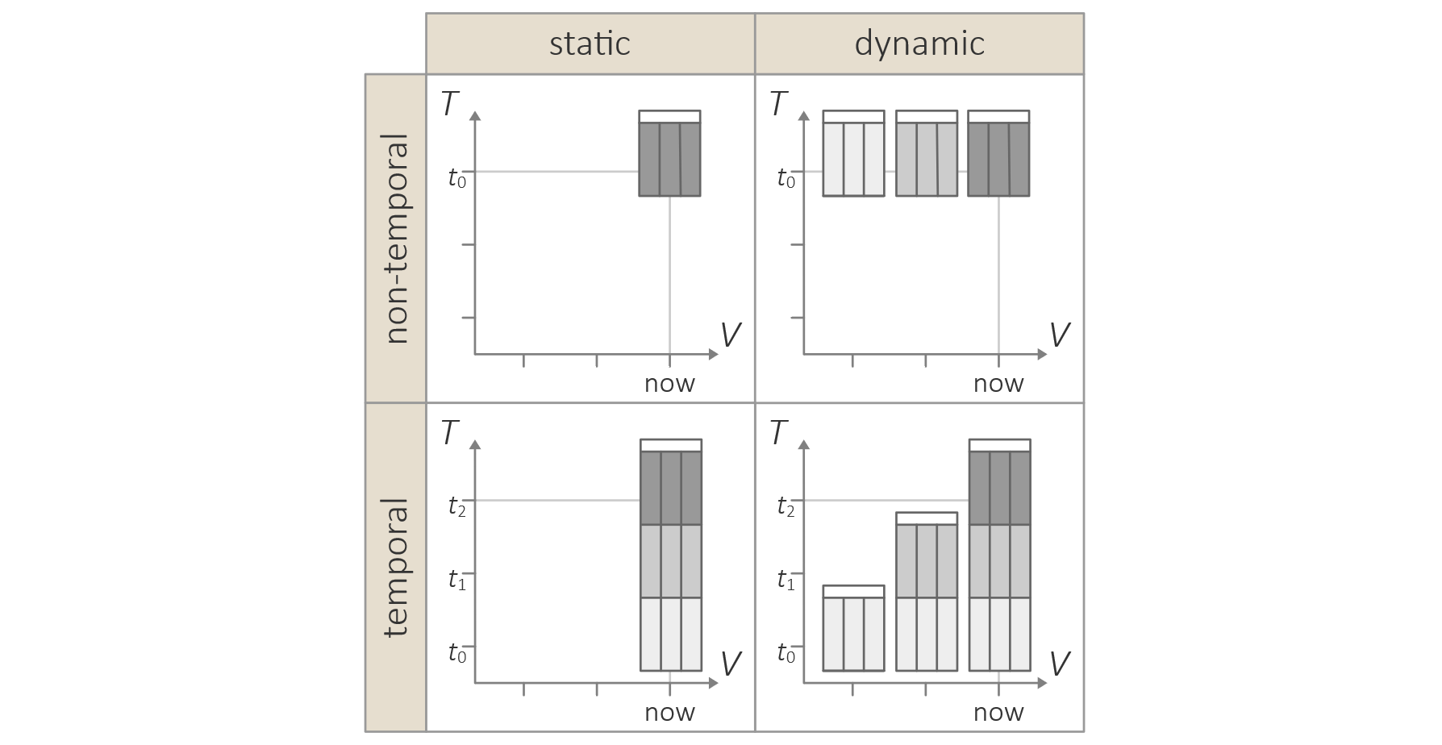
Characterization of temporal data
Are the data related to time?
Non-temporal vs. temporal data
Are the data in some way related to time → Temporal data
Otherwise → Non-temporal data
Are there different versions of the data?
Static vs. dynamic data
Does the dataset itself change over time → Dynamic data
Otherwise → Static data
Think about: What are example data for each category?
Notes:
Static, non-temporal data: player statistics in sports data, Iris data set
Dynamic, non-temporal data: live sensor data
Static, temporal data: financial data, health data
Dynamic, temporal data: streaming data, news, tweets, sensor data with history

Slide 13
Analytical questions for temporal data
Various questions can be asked (see MacEachren, 1995 “How Maps Work”)
Existence of data element
Temporal location
Time interval
Temporal pattern
Rate of change
Sequence
Synchronization
As we know from the discussion of visualization tasks from Lecture 2, different tasks require different visualization designs

Slide 14
Analytical questions for temporal data
Existence of data element: Does a data element exist at a specific time?
Given: Time point or time interval
Find: Data element at that time
Example: “Was a stock price available on June 1, 2020?”
Temporal location: When does a data element exist in time?
Given: Data element
Find: Time point or time interval with data element
Example: “When did the stock price exceed 100€?”

Slide 15
Analytical questions for temporal data
Time interval: How long is the time span from begin to end of the data element?
Given: Data element
Find: Duration
Example: “For how long has the stock price been above 100€ ?”
Temporal pattern: How often does a data element occur?
Given: Interval in time
Find: Frequency and patterns of data elements within a certain portion of time
Example: “How many ad-hoc news were published by the company this year?”

Slide 16
Analytical questions for temporal data
Rate of change: How fast is a data element changing or how much difference is there from data element to data element over time?
Given: Data element
Find: Magnitude of change over time
Example: “How did the stock price vary in the last year?”
Sequence: In what order do data elements occur?
Given: Data elements
Find: Temporal order of data elements
Example: “Did the decline start before or after the ad-hoc news publication?”

Slide 17
Analytical questions for temporal data
Synchronization: Do data elements exist together?
Given: Data elements
Find: Occurrence of data elements at the same point or interval in time
Example: “Is our decline coincident with the rise of another company?”

Slide 18
Fundamental visualization strategies
We now know the relevant properties and characteristics of time and temporal data, and the associated analytical questions
Next, we look at visualization strategies and concrete approaches that take these characteristics into account
Our focus will be on static temporal data
Examples:
Representing instants and intervals
Linear and cyclic visualization
Considering granularity
Visualizing time with branching structure

Slide 19
Fundamental visualization strategies
Basically, all options and guidelines of visual encoding apply
Two fundamental strategies specifically for temporal data
Static: Map time to space
Time is mapped to a visual variable; time is often mapped to position along a display axis
Overview of time in one static image
Dynamic: Map time to time
Time in the data is mapped to time of the presentation (i.e., animation)
Visual representation changes dynamically, for each time primitive in the data, a separate image is shown

Slide 20
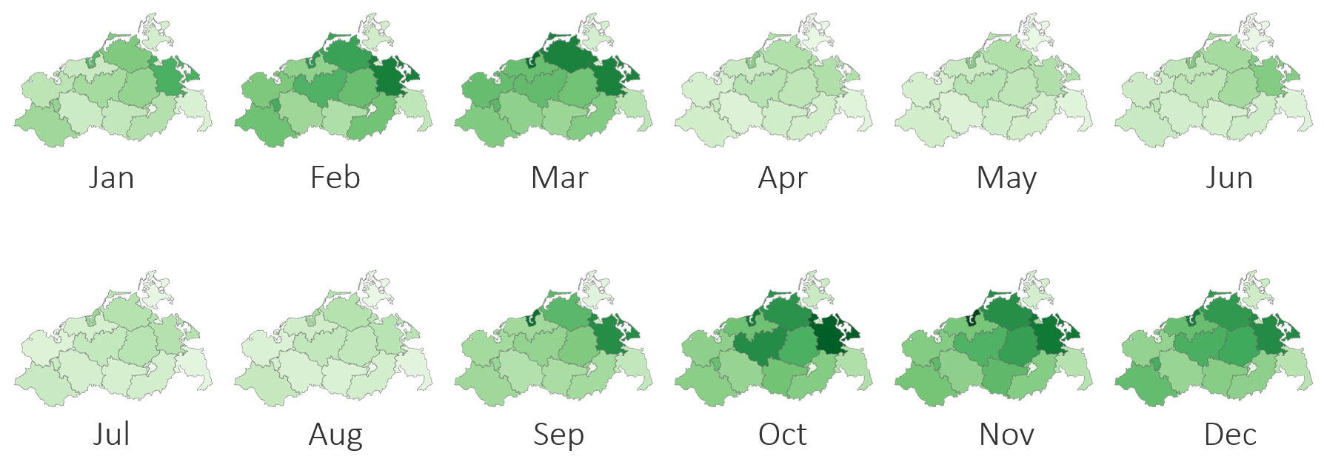
Fundamental visualization strategies
Static: Map time to space
Example: Small multiples (Tufte, 1983)
Small miniature visualization for each time primitive
Dynamic: Map time to time
Example: Animated scatterplot
Gapminder https://www.youtube.com/watch?v=hVimVzgtD6w
Static vs. dynamic
Think about: What are the benefits and difficulties of both strategies?
Notes:
Static:
Good for overview of time and general comparison, but requires much display space
Dynamic:
Good for communicating dynamics, but less suited for overview and comparison
Requires time
Both:
Usually overview+detail or focus+context required to see both big picture and details

Slide 21
Fundamental visualization strategies
Static
Dynamic
Pro:
Focus on state
Details visible
Direct comparison of several points in time
Con:
Requires much display space
Can get cluttered for long time series
Pro:
Focus on process
General overview
Dynamics of data well represented
Con:
Requires time to consume
Some cognitive efforts required for digesting longer and complex dynamic representations
Notes:
Static:
Good for overview of time and general comparison, but requires much display space
Dynamic:
Good for communicating dynamics, but less suited for overview and comparison
Requires time
Both:
Usually overview+detail or focus+context required to see both big picture and details

Slide 22
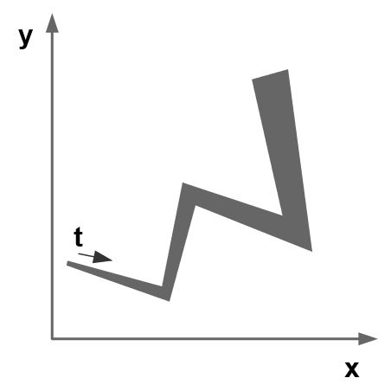
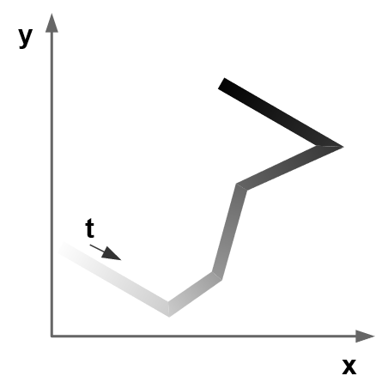
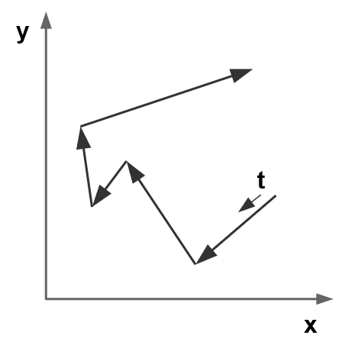
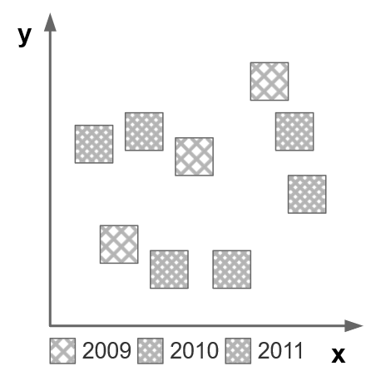
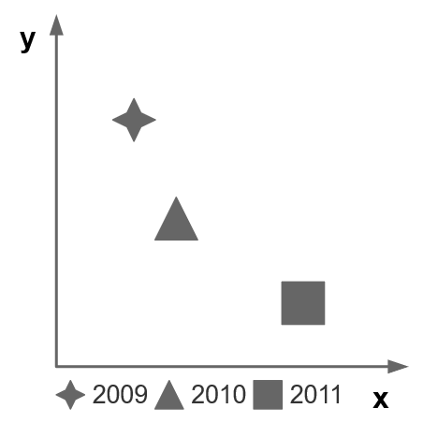
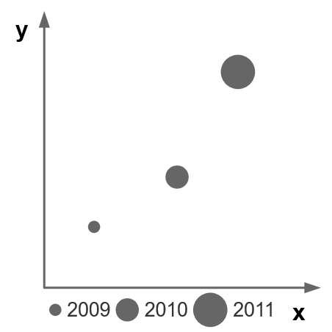
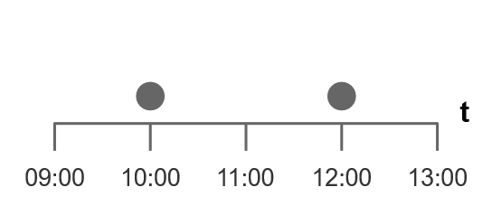
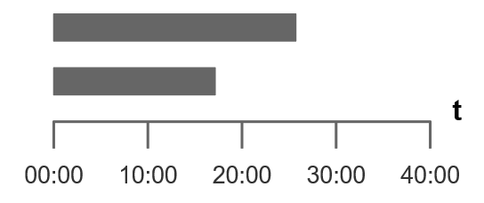
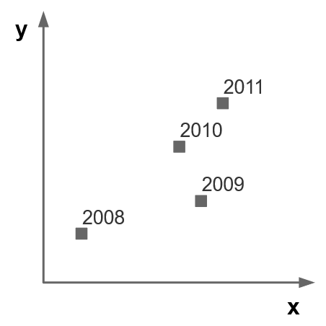
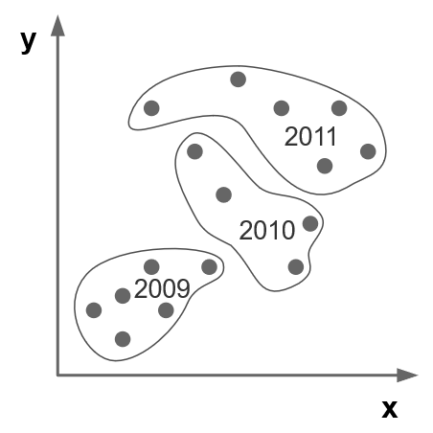
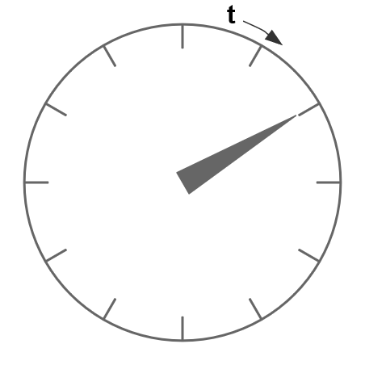
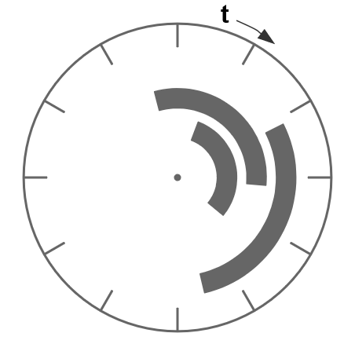
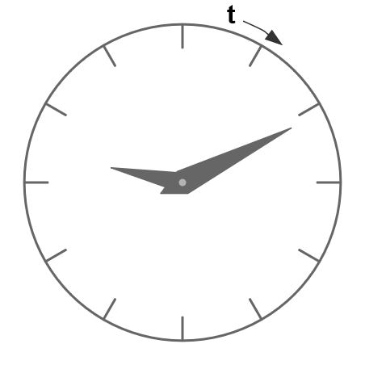
Visualization techniques
Visual encoding of time
Map time to basic visual variables
Line width
Brightness
Connection
Recall the visual mapping from Lecture 4.
Position
Length
Texture
Symbol
Size
Angle and slope
Text label
Containment

Slide 23
Visualization techniques
Visual encoding of temporal data
Too many techniques to discuss in this lecture
Focus on examples
Representing time instants and time intervals
Representing linear time and cyclic time
Considering time granularity
Visualizing branching time

Slide 24
Representing instants and intervals
Many applications work with data associated with time instants (or time points, time steps), the visualization must communicate
Location of the instants in time
One or more attribute values per time instant
Some scenarios work with attribute values that are valid for time intervals, the visualization must communicate
Start and end (and duration) of intervals
One or more attribute values per time instant

Slide 25
Representing instants and intervals
Think about: Are Parallel Coordinates Plots suitable for visualizing multivariate time-dependent attributes?
Notes:
PCP are only of limited use
Difficult to connect all time-dependent attributes to the time axis

Slide 26
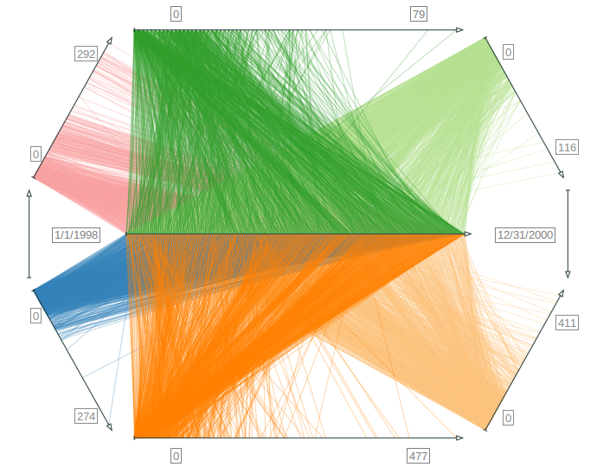
Representing instants and intervals
Time Wheel for time instants
Axes-based visualization
Central axis represents time
Radially arranged axes show multiple time-dependent attributes
Lines connect time instants and attribute values
Focus+context stretching of axes
Rotation of attribute axes around central time axis
Recall the axes-based visualization from Lecture 5.

Slide 27
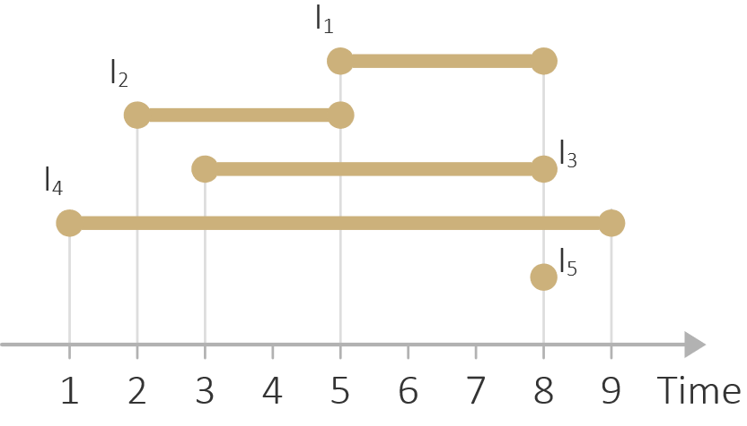
Representing instants and intervals
Think about: How would you intuitively visualize many time intervals?

Slide 28
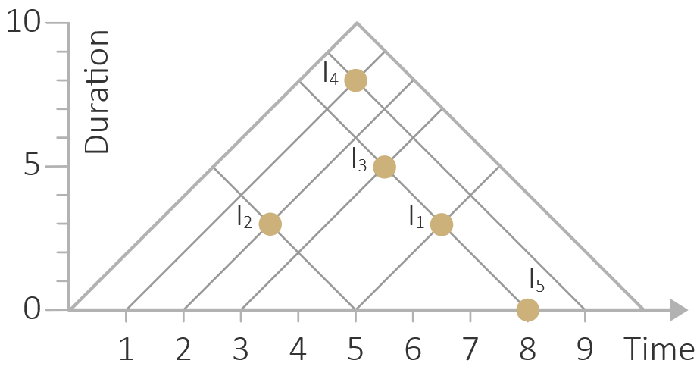
Representing instants and intervals
Triangular model for time intervals
X axis represents time
Y axis represents duration
Intervals shown as dots
Many intervals can be visualized using only little visual resources

Slide 29
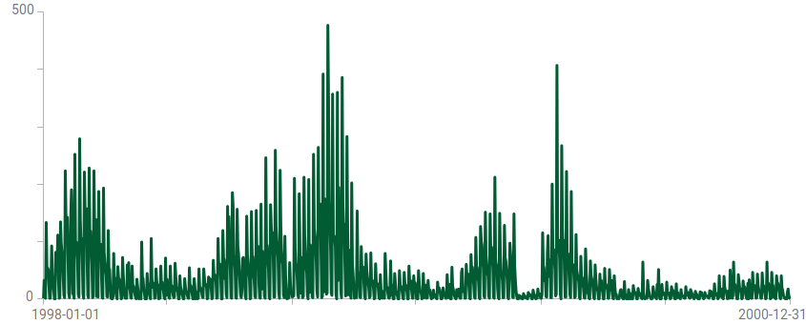
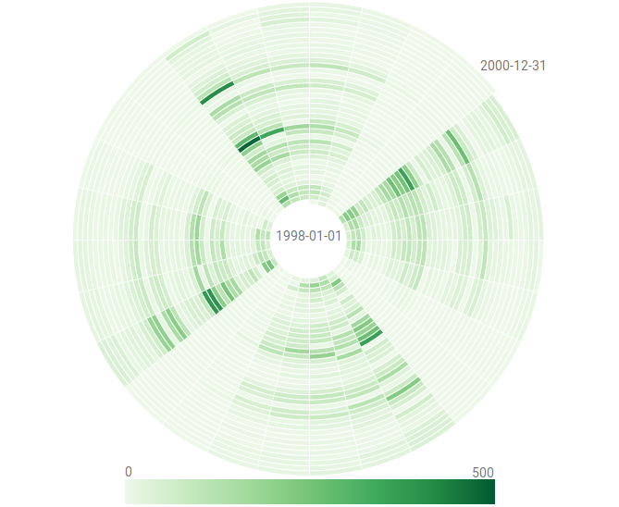
Linear and cyclic visualization
Many standard visualization approaches follow the convention to represent time linearly from left to right, which allows us to see linear trends
Alternatively, time can be represented radially, which makes it easier to see cyclic patterns
Recall the representation effect from Lecture 4.

Slide 30
Linear and cyclic visualization
Stream graph for linear time
Multiple stacked bands (or streams), one per variable
Thickness of bands varies with changing data values over time

Slide 31
Linear and cyclic visualization
Stream graph for linear time
Think about: Do you see a problem with stream graph representations?

Slide 32
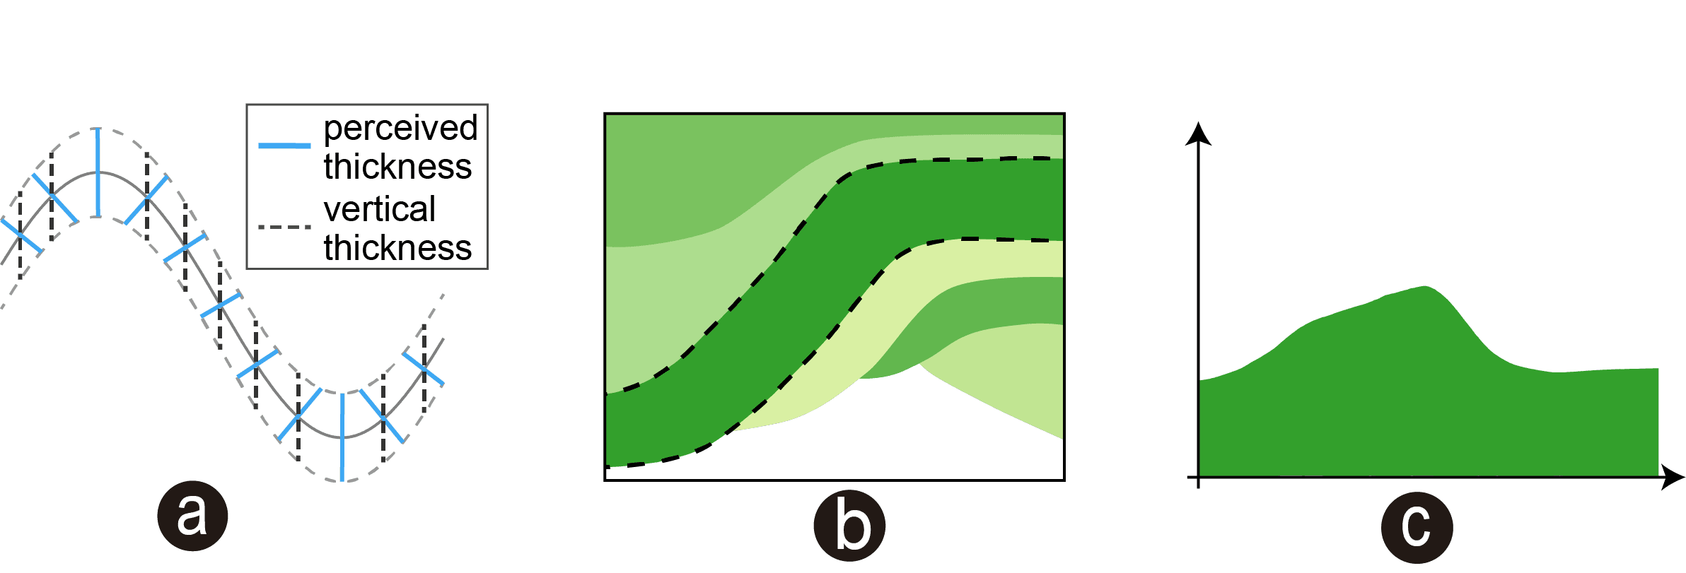
Linear and cyclic visualization
Stream graph for linear time
Problem: Sine illusion! Thickness encoded along y-axis, but perceived perpendicular to band direction.
https://michaelbach.de/ot/sze-sineIllusion/index.html
https://ideaslab.wang/sinestream-improving-the-readability-of-streamgraphs-by-minimizing-sine-illusion-effects

Slide 33
Linear and cyclic visualization
Stream graph for linear time
Problem: Sine illusion! Thickness encoded along y-axis, but perceived perpendicular to band direction.
Possible solutions:
Reorder bands
Adjust baseline
https://ideaslab.wang/sinestream-improving-the-readability-of-streamgraphs-by-minimizing-sine-illusion-effects

Slide 34
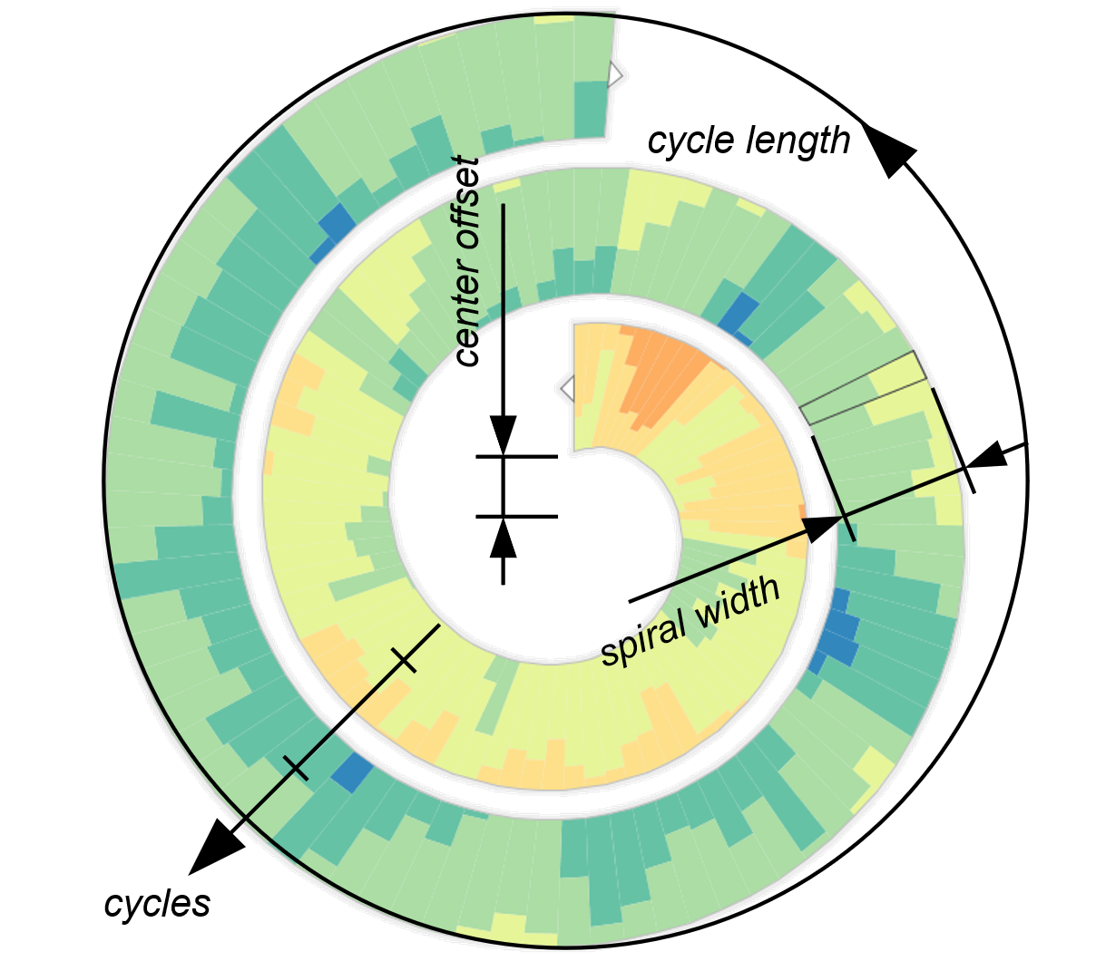
Linear and cyclic visualization
Spiral display for cyclic time
Time axis mapped to spiral shape
Number of data values per spiral cycle decides if and what cyclic patterns can be seen (adjustments must be possible)
Per spiral segment, different options for visualizing data value
Color coding
Bars
Two-tone pseudo coloring

Slide 35
Linear and cyclic visualization
Spiral display for cyclic time
Think about: How to draw a spiral segment?

Slide 36
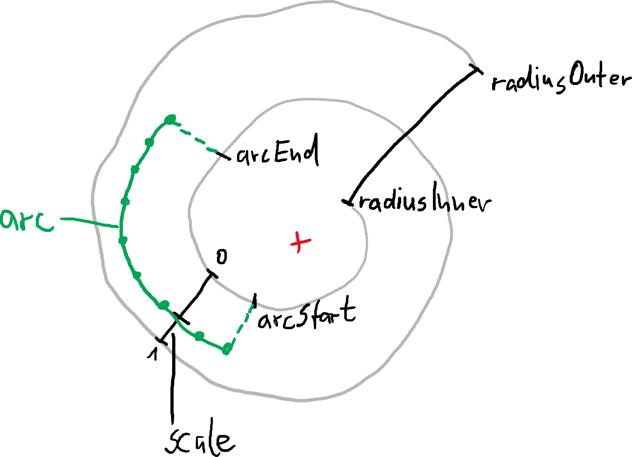
Linear and cyclic visualization
Spiral display for cyclic time
Archimedean spiral $r=a∙φ$
https://www.desmos.com/calculator/cezqlgdrlw

Slide 37
Linear and cyclic visualization
Spiral display for cyclic time
Archimedean spiral $r=a∙φ$
Compute max. $φ$ according to
Number of cycles
Compute a according to
Max. $φ$
Inner radius
Outer radius
Compute points on arc between
Start of arc
End of arc
function spiralArc(cycles, radiusInner, radiusOuter, arcStart, arcEnd, scale) { // Spiral constants const phi = Constants.MATH_PI_DOUBLE * cycles; // Maximum angle of spiral phi const a = (radiusOuter - radiusInner) / (phi + Constants.MATH_PI_DOUBLE); // Spiral constant a // Offset for scaling arc between two successive cylces const scaleOffset = scale * Constants.MATH_PI_DOUBLE * a; // Functions to compute spiral geometry const radius = (angle) => Math.max(angle * a + radiusInner + scaleOffset, 0); const point = (angle, radius) => [radius * Math.cos(angle), radius * Math.sin(angle)]; let [angle, r] = [arcStart, radius(arcStart)]; // Start anlge and radius of spiral arc let arc = [point(angle, r)]; // Initial point of spiral arc const heightTolerance = 1; // Tolerance error when using arc segment height while (angle < arcEnd) { // Loop for step-wise construction of points on arc // Compute angle step based on a maximum arc height, i.e., max. difference between
// actual spiral and our linear approximation
// (see http://en.wikipedia.org/wiki/Circular_segment for formulas) let step = 2 * Math.acos(1 - heightTolerance / r); // Compute angle step angle = Math.min(angle + step, arcEnd); // Update angle and limit it to the arc's end r = radius(angle); // Update radius arc.push(point(angle, r)); // Add point to arc } return arc; }

Slide 38
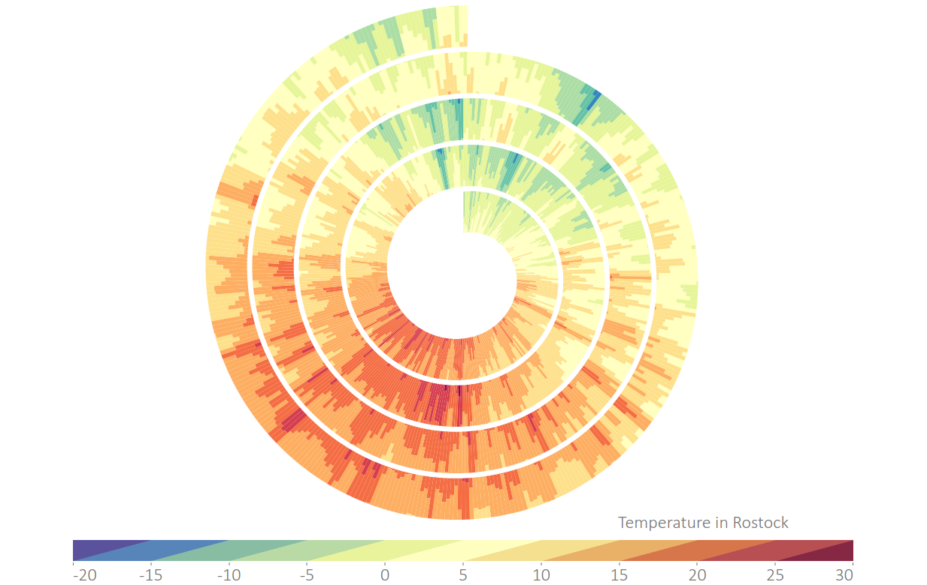
Linear and cyclic visualization
Spiral display for cyclic time
Think about: Where can we see cyclic patterns?
Think about: Can we see linear trends as well?
https://vcg.informatik.uni-rostock.de/~ct/software/EnhancedSpiral.js/index.html

Slide 39
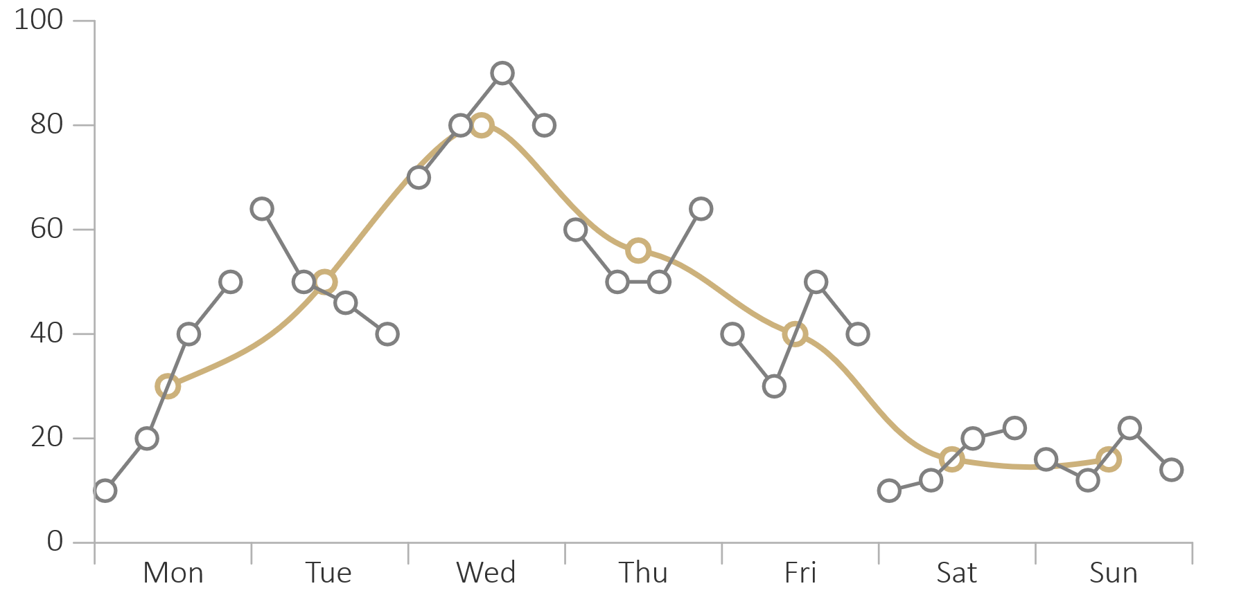
Linear and cyclic visualization
Cycle plot for combining linear and cyclic time
Show single large plot for recurring time primitives (week day in the example)
Show multiple smaller plots for linear trends per recurring time primitive (Monday’s trend, Tuesday’s trend, etc.)
Line plot
Cycle plot

Slide 40
Considering granularity
Previous examples: Temporal data given at a single granularity (mostly dates)
Now: Temporal data with multiple granularities
Multiple granularities
Relevant patterns appear at several granularities (or scales)
Need different visual representations for the different granularities
Examples:
Energy consumption
People present at work

Slide 41
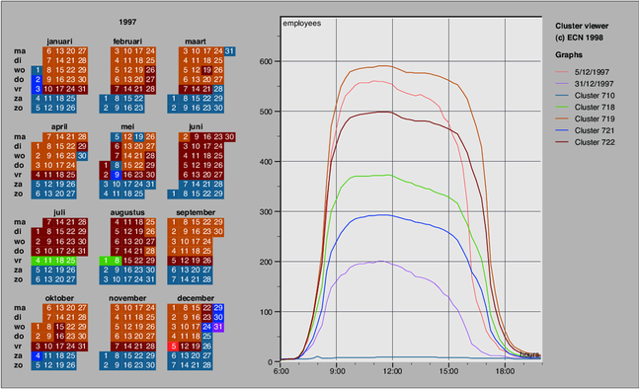
Considering granularity
Cluster and calendar-based visualization
Given: Measurement given for time of day (high granularity)
Analytic question: How does measurement evolve over a day?
Solution: Line plot
Can see daily evolution
Many curves in plot (one per day) can lead to over-plotting
Van Wijk & van Selow (1999)

Slide 42
Considering granularity
Cluster and calendar-based visualization
Given: Measurement given for time of day (high granularity)
Analytic question: Which daily pattern are common or outliers?
Solution: Cluster-based calendar plot
Cluster curves (i.e., daily patterns)
Assign color to each cluster
Color-code calendar according to cluster affiliation
Van Wijk & van Selow (1999)

Slide 43
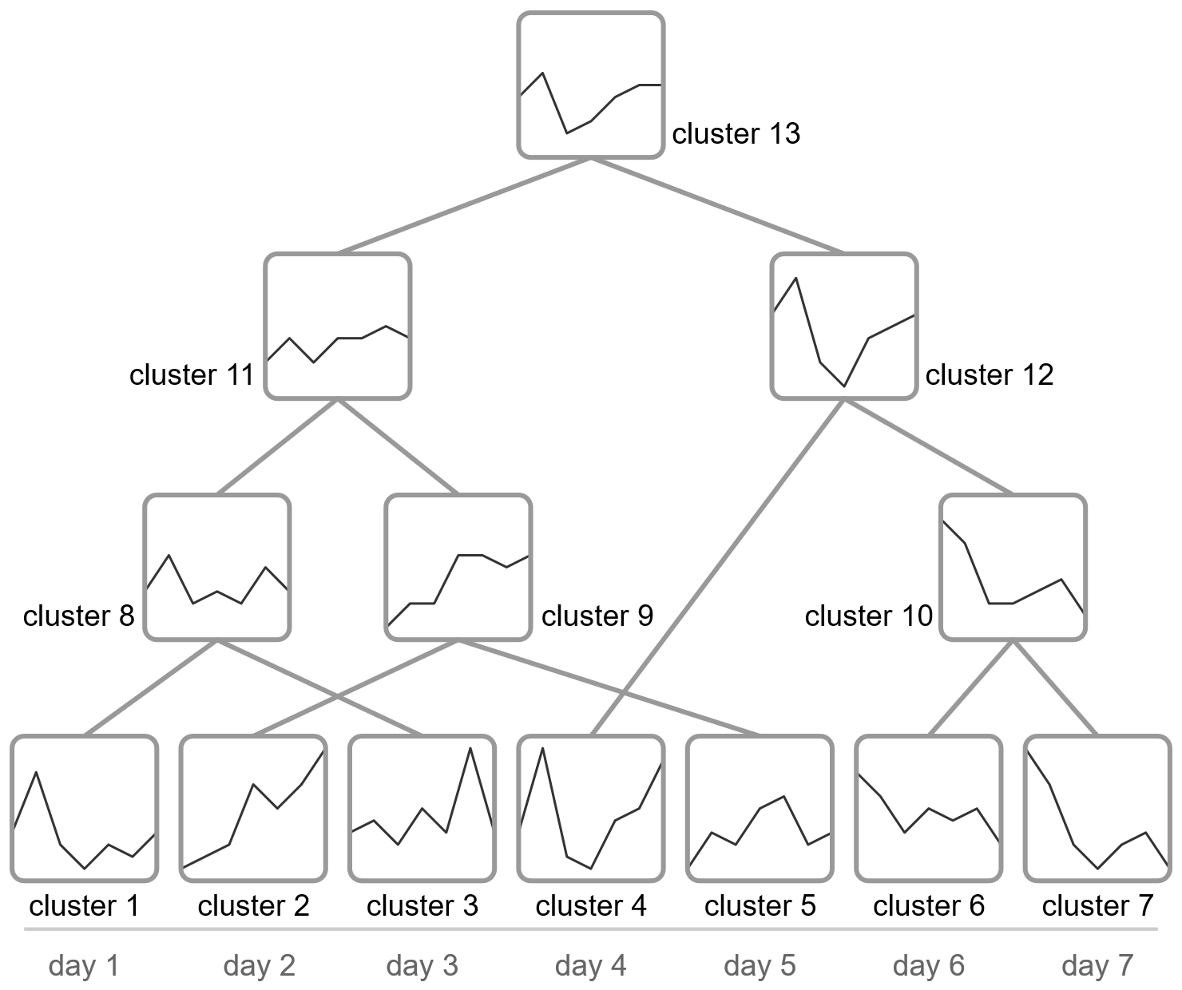
Considering granularity
Cluster and calendar-based visualization
Think about: How to cluster daily plots?
Hierarchical clustering:
Compute similarity of plots (different similarity metrics possible)
Merge two most similar plots to a new cluster with its own representative plot
Continue with 1. until hierarchy is complete

Slide 44
Visualizing time with branching structure
Previous examples: Ordered time, where temporal primitives form a sequence
Now: Branching time
Recall: Branching time
Different alternative paths of time exist
Uncertainty w.r.t. what will actually happen
Example: Planning scenarios

Slide 45
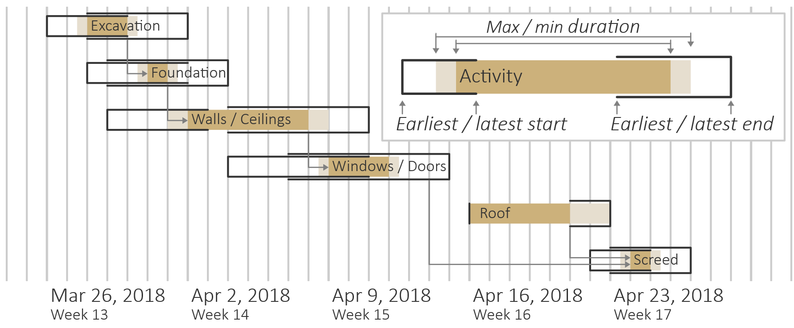
Visualizing time with branching structure
Planning lines for planning with uncertainty
Intervals represented as capped bars to encode
Earliest/latest start
Earliest/latest end
Max./min. duration
Bars arranged on temporal grid to encode
Temporal location
Potential branches and convergences

Slide 46
Visualization of temporal data
Summary
Fundamental strategies: static vs. dynamic representation
Basic visual mapping of time to visual variables
Overview of selected techniques for visualizing temporal data
Instants vs. intervals
Linear vs. cyclic time
Multiple granularities
Branching time with uncertainties
Many more techniques known in the literature: The TimeViz Browser

Slide 47
The TimeViz Browser
Public website with more than 150 different techniques
Each technique
Brief description
Illustrating figure
Relevant references
Categorization of techniques according to simple criteria
Time: Primitives: Points vs. intervals, Arrangement: linear vs. cyclic
Data: Number of variables: single vs. multiple; Frame of reference: abstract vs. spatial
Visual representation: Mapping of time: Static vs. dynamic; Dimensionality: 2D vs. 3D
Filter by category, full-text search, tagging

Slide 48
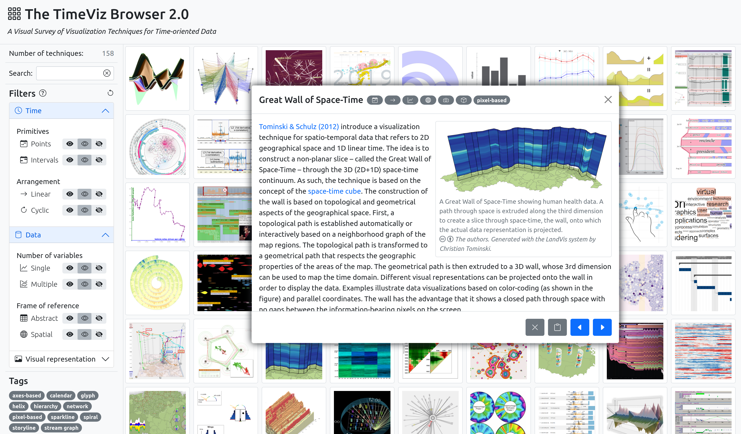
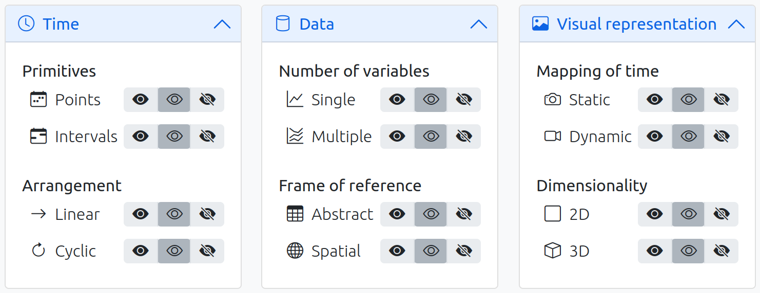
The TimeViz Browser
Demo

Slide 49
Assignments
Read about optimization strategies to mitigate sine illusion in Bu et al. (2021)!
Generate and interpret spiral representations for different search terms at https://wikipulse.com!
Read about cluster and calendar-based visualization in Van Wijk & van Selow (1999)!
Learn at least five additional visualization techniques listed in the TimeViz Browser!

Slide 50
Questions
Give examples of relevant analytical questions regarding temporal data!
How is the dimension of time characterized?
What is the difference between temporal and dynamic data?
What are pros and cons of mapping time to space vs. time to time?
How does the TimeWheel work?
What is a problem with stream graphs and how can it be mitigated?
How can a spiral segment be rendered?
How can similar daily plots be clustered?
What are PlanningLines good for?
What techniques did you find most interesting in the TimeViz Browser?

